Slide 1
CoLux: Multi-Object 3D Micro-Motion Analysis Using Speckle Imaging
By,
Maneesha
Sravya
Uday

Slide 2
Introduction
The ability to measure extremely small non-rigid or multi-object motion has a wide range of applications, from biological cell imaging, to hand-gesture recognition for user interfaces.
Motivation: The fact that micro-motion gestures are difficult, if not impossible, to capture with conventional vision sensors alone.

Slide 3
SpeDo
What is Ego-Motion sensor?
Doesn’t work with low frequency textures.
Doesn’t work with Small Depth variations.
To solve this, we use SpeDo(Speckle defocus based odometer).
Speckle Imaging.
Speckle flow : It is the motion of Speckle as a function of sensor motion.

Slide 4
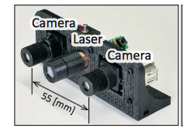
How is Speckle used to detect motion?
Bi-Focal SpeDo to recover 6 DOF.
Ego-Motion recovery algorithm.

Slide 5
Introduction to CoLux
Multi-Object 3D Micro-Motion Analysis Using Speckle Imaging.
In the paper they present a simple technique based on global scale-space speckle motion analysis for measuring small (5-50 microns) compound motion of multiple objects, along all three axes.
Coherent light, on interacting with optically rough surfaces, creates a high-frequency speckle pattern in the captured images.
The motion sensitivity of a speckle imaging system is directly proportional to the amount of sensor defocus.

Slide 6
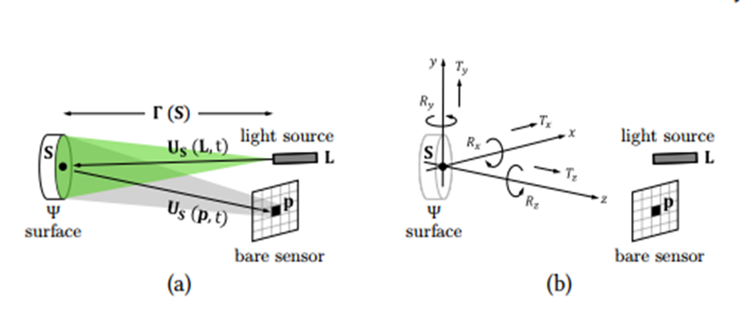
PROPERTIES OF SPECKLE :
Statistical randomness.
High spatial frequency.

Slide 7
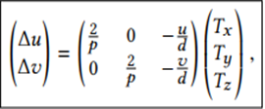
SPECKLE MOTION MODEL: RIGID MOTION
A well known result in optics is that small object motion does not change the speckle pattern, but only translates or scales it by a small amount. This result, known as the homology condition or more recently as the memory effect
Suppose the patch undergoes a small 6 DOF rigid motion given by a translation vector T = [Tx ,Ty,Tz ] , and a rotation vector T = [Rx , Ry, Rz ]. Let I(u,v) and I’(u,v) be the two speckle images captured by the sensor, before and after the motion, respectively.
The relationship between speckle motion [∆u, ∆v] in the image and the object translation in 3D space is given by:

Slide 8
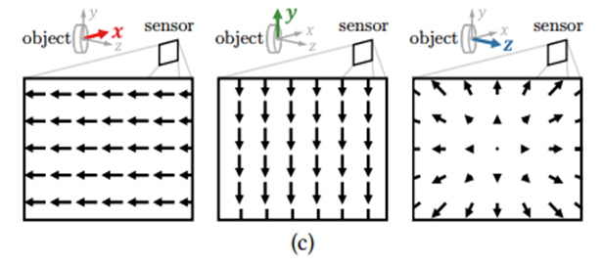
where p is the side length of the sensor pixels (assuming square pixels), and d is the distance between scene point S and the light source
3D (3-AXIS) COMPOUND MICRO-MOTION MEASUREMENT:
Measuring Lateral Object Translation
Consider a single object translating laterally (i.e., parallel to the sensor, or x-y, plane), so that the object motion between two successive speckle images I and I’ is given by the translation vector T = [Tx ,Ty, 0] . The resulting speckle motion is given by the speckle flow vector [∆u, ∆v] = 2 p [Tx ,Ty ].

Slide 9
Measuring Axial Object Translation
Consider an object translating axially (i.e., parallel to the z axis), so that the motion between two successive speckle images I and I’ is given by the vector T= [0, 0,Tz]. The resulting speckle motion is given by the vector [∆u, ∆v] = [ −u/d Tz ,−v/d Tz].
Measuring Compound Object Translation
The motion of an object undergoing compound translation (simultaneous lateral and axial motion), given by the translation vector T = [Tx ,Ty,Tz ]. Then, the object translation vector can be recovered as:

Slide 10
Speckle Motion Model : Multi-Object Motion
Speckle formation for multiple objects.
Eliminating the Cross Speckle Term.
It vanishes if the light source has high temporal, but low spatial coherence.
Measuring Multiple Simultaneous Motions.

Slide 11
Pros and Cons
This global technique achieves higher axial motion sensitivity(<50µm)as compared to previous speckle based motion estimation approaches.
Limitations:
Measuring rotation.
Effect of material properties.
Optimizing gesture recognition system.

Slide 12
Why CoLux?
SpeDo is limited to single body rigid motion estimation while CoLux is multi-object micro motion estimation.
CoLux has considerably high axial motion sensitivity.
CoLux can detect much multiple motions.
In the experimental setup, CoLux performed exceptionally well.

Slide 13
CONCLUSION
Thus, Hand gesture recognition is explained through Micro-Motion Analysis Using Speckle Imaging.
In addition to reducing cost and hardware complexity, by the usage of a bare (lens-less ) sensor, the extreme defocus of it resulted in extreme axial motion sensitivity.

Slide 14
FUTURE WORK
Measuring rotation: Motion of a rigid body in all the three dimensions is calculated. An interesting future direction is to extend the speckle motion model to measuring multiple rotations.
Effect of material properties: Homology conditions do not hold if the scene consists of scattering objects. Given the interplay between material properties and motion, a promising avenue is to develop similar techniques to jointly recover motion and material.
Optimizing gesture recognition system: To incorporate conventional vision into the system, and explore more powerful machine learning techniques, such as deep neural networks, to potentially achieve significant performance improvement over our simple random forest classifier.

Slide 15
References
P. Jacquot and P. K. Rastogi. 1979. Speckle motions induced by rigid-body movements in freespace geometry: an explicit investigation and extension to new cases. Applied Optics (1979).
M. L. Jakobsen, H. T. Yura, and S. G. Hanson. 2012. Spatial ltering velocimetry of objective speckles for measuring out-of-plane motion. Applied Optics 51, 9 (2012).

